Slide 1
Structured Programming Language - 5
Gourab Saha
Lecturer
CSE, UIU
Ajwad Akil
Lecturer
CSE, UIU

Slide 2
Loops
For loop
While loop
Do while loop

Slide 3
For Loop
Structure of the loop for(initialization; condition; update)statement; example: for(counter = 1; counter<=n; counter++){ printf(“%d”, counter); }
Each part of the for loop is optional under certain cases
Initialization -> Condition -> Statement -> Update -> back to condition -> Break the loop

Slide 4
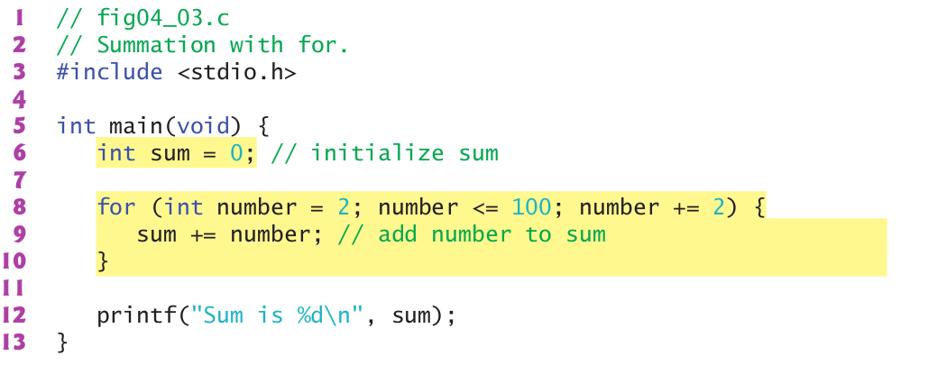
For Loop

Slide 5
Infinite Loop
No terminating condition inside loop example: for(counter = 0;; counter++){}

Slide 6
While loop
Structure while(condition) statement; Example: counter = 1; while ( counter <= 10) { printf(“%d”, counter); counter++; }

Slide 7
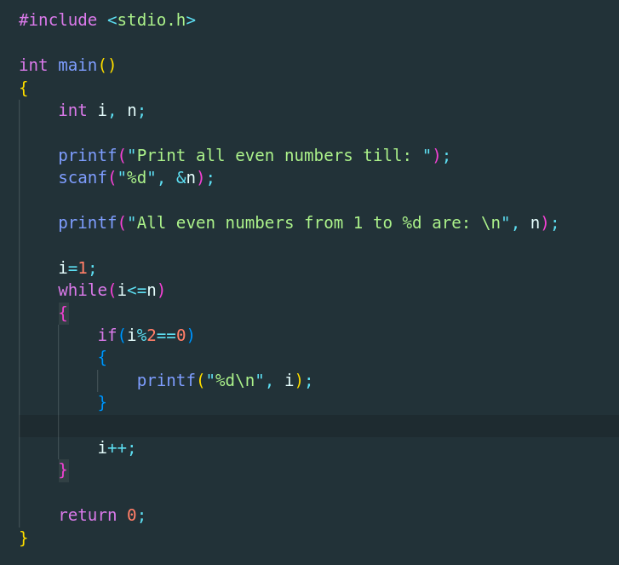
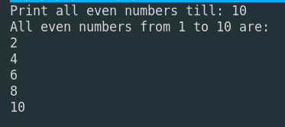
While loop

Slide 8
Do while loop
Structure do statement while(condition); example: counter = 1; do { printf(“%d”, counter); counter++; } while( counter<= 10);
Difference between it and while loop is that body of do while loop executes Once before checking the condition.

Slide 9
Additional Statements
Break
Continue
Goto

Slide 10
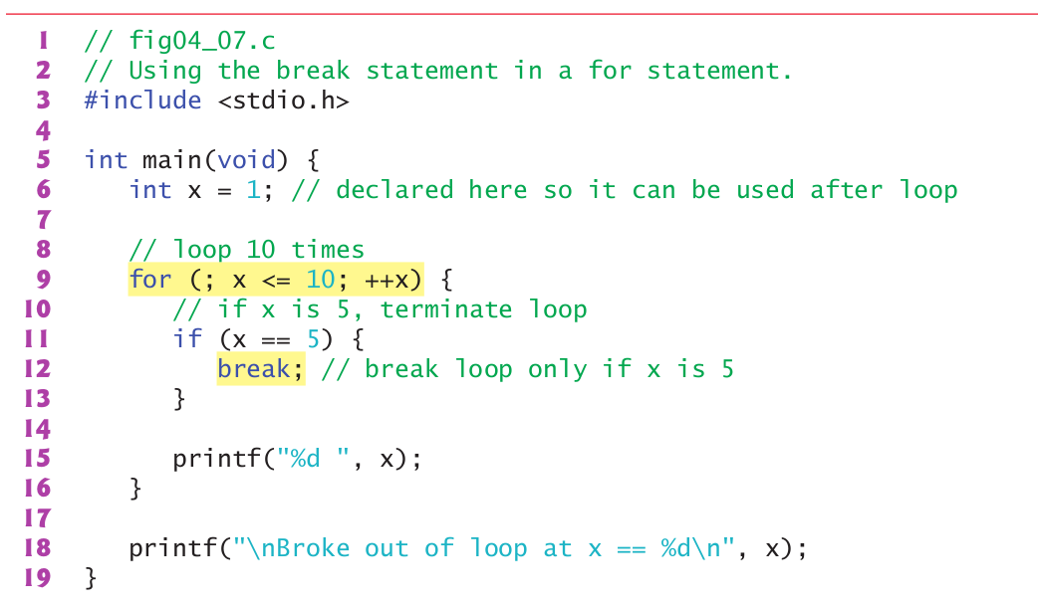
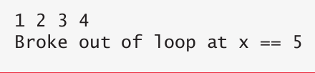
Break

Slide 11
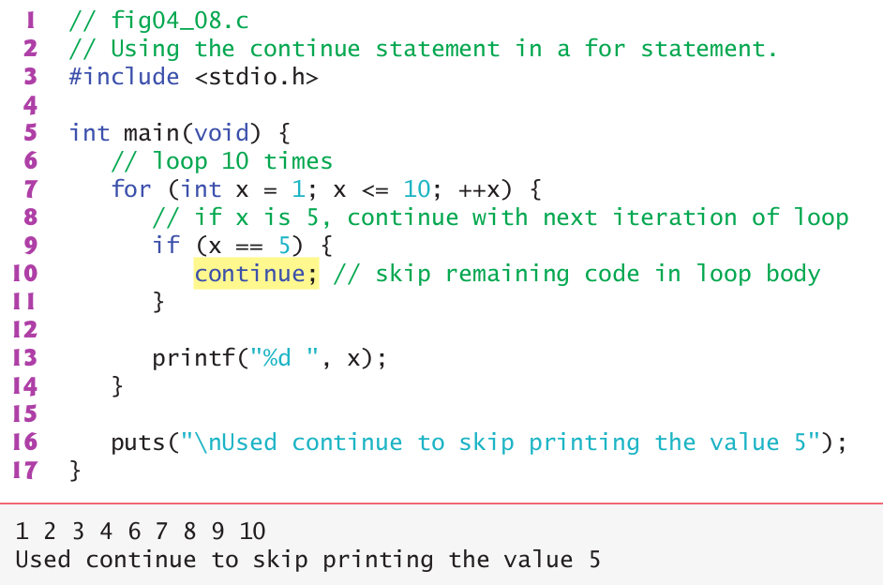
Continue

Slide 12
Some Practice Problems
A person invests $1000.00 in a savings account yielding 5% interest. Assuming all interest is left on deposit in the account, calculate and print the amount of money in the account at the end of each year for 10 years. Use the following
formula for determining these amounts:
a = p(1 + r)^{n}
p is the original amount invested (i.e., the principal, $1000.00 here),
r is the annual interest rate (for example, .05 for 5%),
n is the number of years, which is 10 here, and
a is the amount on deposit at the end of the nth year.

Slide 13
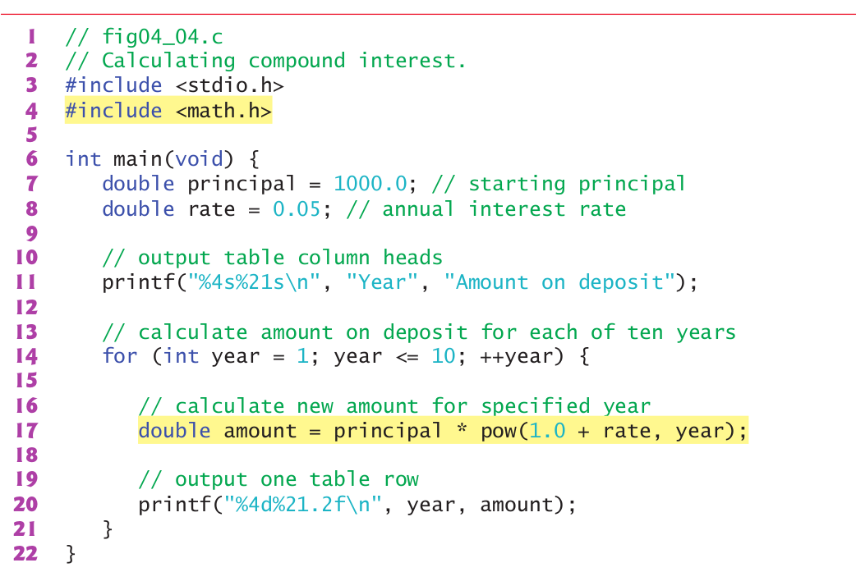
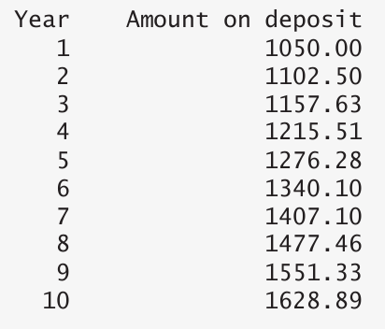
Some Practice Problems

Slide 14
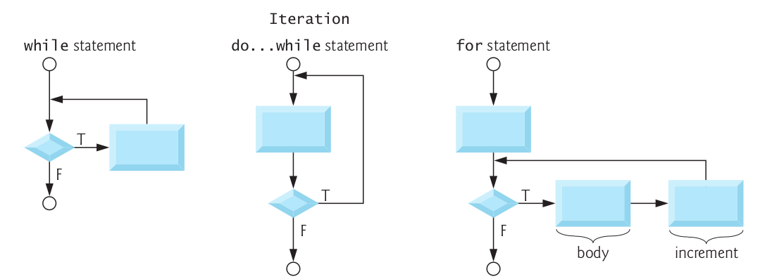
Summary of Loops

